Slide 1

Spark Installation and Configurations

Slide 2
Agenda
Spark Installation Steps
Spark-Shell
SparkContext
SparkConf
Spark-Shell Parameters
Spark History Server

Slide 3
Spark Installation:
1. wget http://d3kbcqa49mib13.cloudfront.net/spark-2.0.0-bin-hadoop2.7.tgz
2. tar xvf spark-2.0.0-bin-hadoop2.7.tgz
3. sudo mkdir /usr/local/spark
4. sudo cp -r spark-2.0.0-bin-hadoop2.7/* /usr/local/spark
5. export SPARK_EXAMPLES_JAR=/usr/local/spark/examples/jars/spark-examples_2.11-2.0.0.jar
6. PATH=$PATH:$HOME/bin:/usr/local/spark/bin
7. source ~/.bash_profile
8. spark-shell

Slide 4

Spark Shell :-
Spark’s shell provides a simple way to learn the API, as well as a powerful tool to analyze data interactively
Spark comes with interactive 3 types of shell
Spark-shell with scala support
Pyspark with python support
sparkR with R support

Slide 5
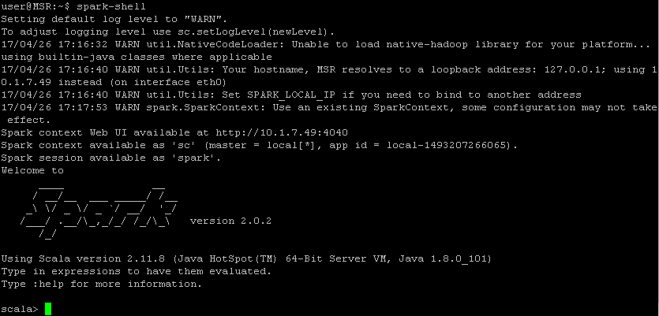
Spark Shell:
Spark-shell

Slide 6
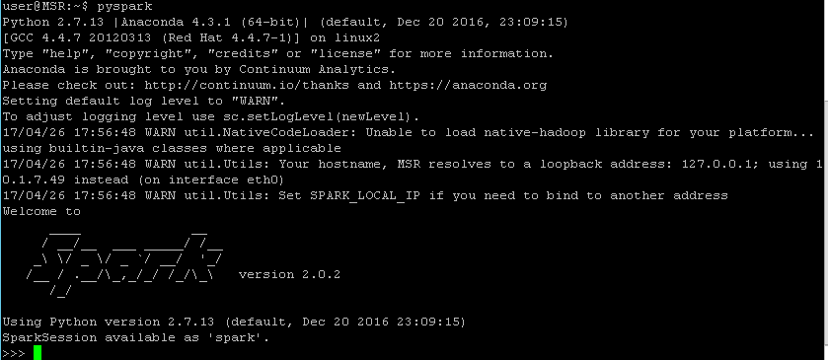
Spark Shell:
pyspark

Slide 7
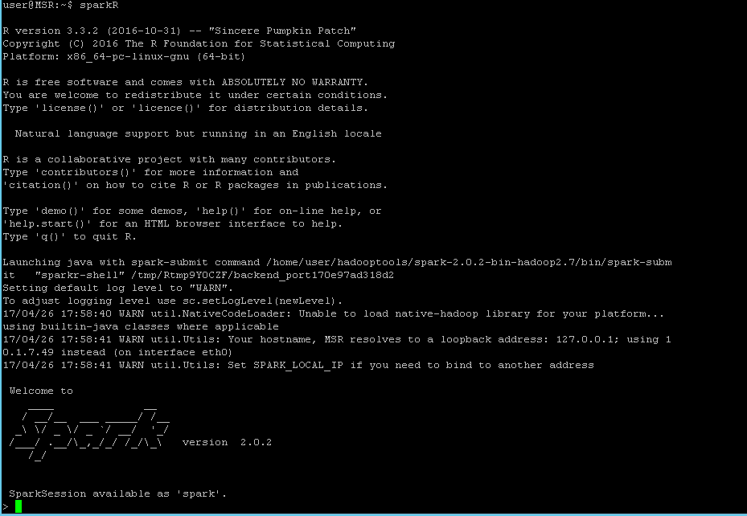
Spark Shell
sparkR

Slide 8
Spark Shell Arguments:
--master MASTER_URL | spark://host:port, mesos://host:port, yarn, or local.
--deploy-mode DEPLOY_MODE | Whether to launch the driver program locally (“client") or on one of the worker machines inside the cluster ("cluster") (Default: client).
--class CLASS_NAME | Your application's main class (for Java / Scala apps).
--name NAME | A name of your application.
--jars JARS | Comma-separated list of local jars to include on the driverand executor classpaths.

Slide 9
Spark Shell Arguments:
--files FILES | Comma-separated list of files to be placed in the working directory of each executor
--conf PROP=VALUE | Arbitrary Spark configuration property.
--properties-file FILE | Path to a file from which to load extra properties. If not specified, this will look for conf/spark-defaults.conf.
--proxy-user NAME | User to impersonate when submitting the application.
--help, -h | Show this help message and exit
--version | Print the version of current Spark
spark-shell --master local[2] --name MyApp1
spark-shell --master yarn --deploy-mode client --name MyApp2 --conf spark.ui.port=4041
spark-shell --master yarn --deploy-mode client --name MyApp2 --conf spark.ui.port=4041 --driver-memory 2G --executor-memory 2G --packages mysql:mysql-connector-java:5.1.30

Slide 10
SparkConf :
SparkConf is the object which hold the all information about the driver.
To instantiate the sparkContext we require two basic needs. That Is master url and Application name.
Ex:
Import org.apache.spark.SparkConf
val conf = new SparkConf()
conf.setMaster(“local”)
Conf.setAppName(“WordCountApp”)

Slide 11
SparkContext :
SparkContext is the starting point of the Application. We require sparkContext to work with spark applications.
To create SparkContext we need master url and application name.
Ex:
Import org.apache.spark.SparkConf
Import org.apache.spark.SparkContext
Val conf = new SparkConf().setMaster(“yarn”).setAppName(“MyApp”)
Val sc = new SparkContext(conf)

Slide 12
Spark Configurations :
Configuration | Default | Description
spark.app.name | None | The name of your application. This will appear in the UI and in log data.
spark.driver.memory | 1g | Amount of memory to use for the driver process, i.e. where SparkContext is initialized. (e.g. 1g, 2g).
spark.executor.memory | 1g | Amount of memory to use per executor process (e.g. 2g, 8g).
spark.local.dir | /tmp | Directory to use for "scratch" space in Spark, including map output files and RDDs that get stored on disk.
spark.logConf | false | Logs the effective SparkConf as INFO when a SparkContext is started.

Slide 13
Spark Configurations :
spark.master | None | The cluster manager to connect to. See the list of allowed master URL's.
spark.submit.deployMode | None` | mode of Spark driver program, either "client" or "cluster",
spark.executor.extraClassPath | None | Extra classpath entries to prepend to the classpath of executors. This exists primarily for backwards-compatibility with older versions of Spark.
spark.jars | None | Comma-separated list of local jars to include on the driver and executor classpaths.
spark.ui.port | 4040 | Port for your application's dashboard, which shows memory and workload data.
sc.stop // only for spark-shell
//import required classes
import org.apache.spark.SparkConf
import org.apache.spark.SparkContext
//must have these two parameters.
val conf = new SparkConf().setMaster("local").setAppName("MyApp")
//optional
conf.set("spark.ui.port","4041")
//create sparkContext using SparkConf
val sc = new SparkContext(conf)

Slide 14
Driver Memory vs Executor Mememory
If the job is based purely on transformations and terminates on some distributed output action like rdd.saveAsTextFile, rdd.saveToCassandra, ... then the memory needs of the driver will be very low. Few 100's of MB will do. The driver is also responsible of delivering files and collecting metrics, but not be involved in data processing.
If the job requires the driver to participate in the computation, like e.g. some ML algo that needs to materialize results and broadcast them on the next iteration, then your job becomes dependent of the amount of data passing through the driver. Operations like .collect,.take and takeSample deliver data to the driver and hence, the driver needs enough memory to allocate such data.

Slide 15
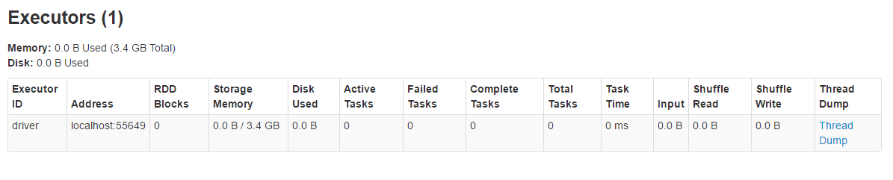
Driver Memory:
Spark-shell –driver-memory 5G or –conf spark.driver.memory=5G

Slide 16
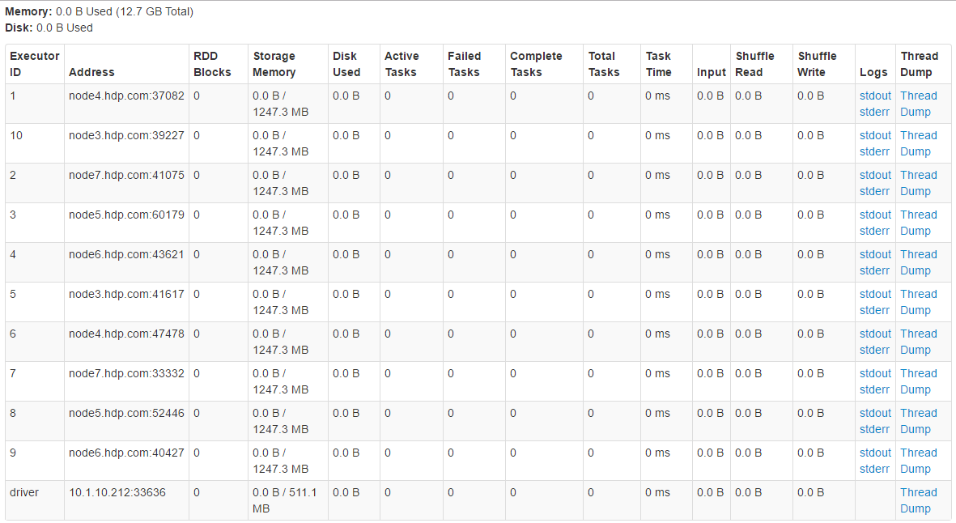
Executor Memory :
Spark-shell –executor-memory 2G –num-executors 10

Slide 17
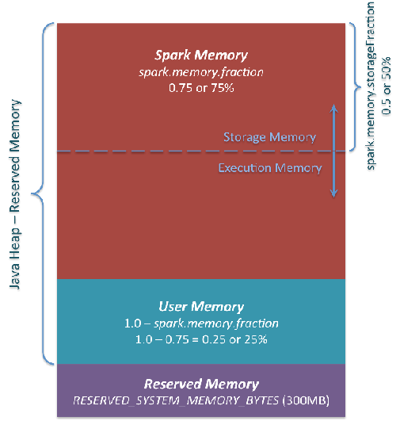
Memory Management in Spark.
Ex:
If you given 1G executor memory
(1024-300)*0.75 = 543MB will be used by spark.
This will apply for driver memory also

Slide 18
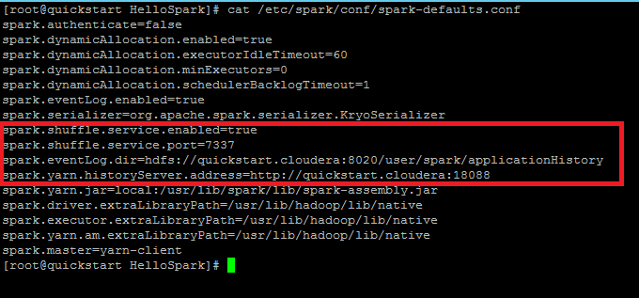
Enable History server :
Uncomment the lines from /etc/spark/conf/spark-defaults.conf
spark.eventLog.enabled true
spark.eventLog.dir hdfs://quickstart.cloudera:8020/user/spark/applicationHistory

Slide 19
QUIZ
What is Driver Memory
What is Executor Memory
What is SparkConf
How to Create SparkContext
If you given 1G executor memory, what is the actual memory used?

Slide 20
Thank You…….
Any Queries…..

